Slide 1
Systems Analysis And Design
Chapter Three: Systems Analysis

Slide 2
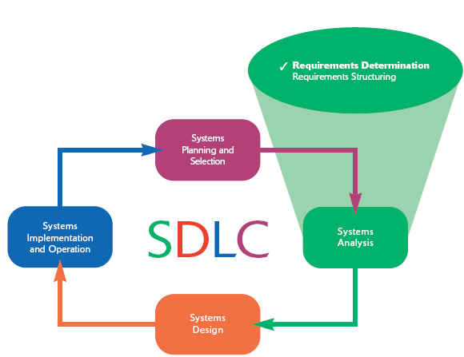

Slide 3
Determining Requirements
During requirements determination, information on what the system should do is gathered from as many sources as possible.
Gathering system requirements is like conducting any investigation and therefore requires the following characteristics.
Impertinence
Impartiality
Relaxing of constraints
Attention to details
Reframing

Slide 4
Determining Requirements cont’d
Impertinence: questioning everything, assumptions and existing processes
It encourages the analyst not to take anything for granted.
It ensures that they explore all possibilities, even if it might seem like overstepping boundaries.
Impartiality: analyst should remain neutral and not favor a stakeholder/solution
ensures fair and balanced requirement gathering without bias toward particular technologies, departments, or individuals
Relaxing of constraints: Analysts should avoid prematurely assuming constraints and limitations, especially those that may be artificial or outdated.
It encourages thinking outside the box and considering what could be possible if certain constraints were lifted.
Attention to details: Thoroughness is key in gathering system requirements.
Missing details can lead to major problems later in development.
Analysts must ensure that every aspect of the system's operation is captured accurately and comprehensively.
Reframing: viewing the problem from different perspectives to identify alternative solutions or uncover hidden requirements.
encourages creativity and deeper understanding of the system's potential impacts and goals.

Slide 5
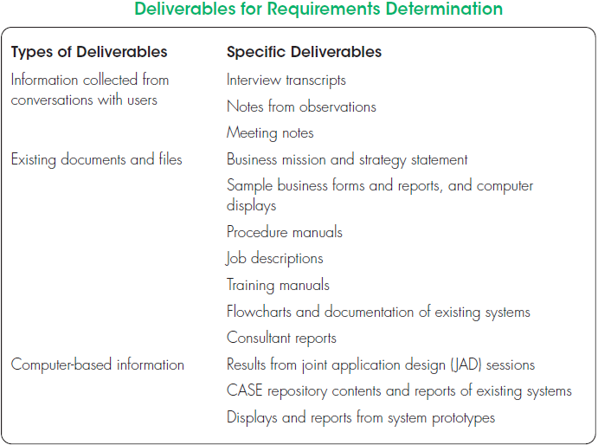

Slide 6
Understanding of the following components of an organization is crucial( in req. Determination):
The business objectives that drive what and how work is done
The information people need to do their jobs
The data handled within the organization to support the jobs
what data are moved, transformed, and stored; When, how, and by whom
The sequence and other dependencies among different data-handling activities
The rules governing how data are handled and processed
Policies and guidelines that describe the nature of the business, the market, and the environment in which it operates
Key events affecting data values and when these events occur

Slide 7
Traditional Methods for Determining Requirements
Collection of information is at the core of systems analysis
One of the best ways to get this information is to talk to those directly or indirectly involved in the different parts of the organization
Another way is to gather copies of documentation relevant to the current systems and business processes
Interview, questionnaire, observation, document analysis

Slide 8
Interviewing
Interviewing is one of the primary ways analysts gather information about an information systems project.
During interviewing, you gather facts, opinions, and speculation and observe body language, emotions, and other signs of what people want and how they assess current systems

Slide 9
Interview Guideline
Guidelines for Effective Interviewing
Plan the interview
Be neutral
Listen and take notes
Review notes
Seek diverse views

Slide 10
Interview Questions
Choosing Interview Questions: it is important to decide on the mix and sequence of open-ended and closed-ended questions to use.
Closed-ended questions: Questions in interviews and on questionnaires that ask those responding to choose from among a set of specified responses.
Open-ended questions: Questions in interviews and on questionnaires that have no prespecified answers.

Slide 11
Interview Questions
Closed-ended questions:
Provide a clear, concise answer.
Easy to analyze and compare across multiple respondents.
Often used to verify facts or elicit binary (yes/no) answers.
Examples
Does the current system allow you to export reports in multiple formats (Yes/No)?
How often does the system crash? (Daily, Weekly, Monthly, Rarely, Never)
Are you satisfied with the system’s response time? (Yes/No)
Do you face security issues when using the system? (Yes/No)
Is training available for new users of the system? (Yes/No)

Slide 12
Interview Questions
When to Use Close-Ended Questions:
When gathering specific facts or statistics.
When trying to confirm or deny specific functionalities of the system.
When comparing the responses of different users about a particular feature or performance issue.
Benefits:
Simple to analyze, especially for large-scale surveys.
Provide clear, specific data points that are easy to report.
Can help guide the conversation or narrow down focus on certain areas.
Drawbacks:
Limit the depth of information that can be gathered.
May not capture user frustrations or nuances in their experience.
Respondents might feel constrained if they cannot explain their answers fully.

Slide 13
Interview Questions
Open-ended questions:
Encourage more elaborate, thoughtful responses.
Provide qualitative data that can reveal hidden problems, needs, or opportunities.
Useful for understanding user perspectives, experiences, and suggestions.
Examples
Can you describe how the current system supports your day-to-day tasks? The integration of resource in the organizations?
What are the biggest challenges you face when using the system?
In your opinion, how can the system be improved to better meet your needs?
How does the system’s performance impact your productivity?
What features do you think are missing from the current system?

Slide 14
Interview Questions
When to Use Open-Ended Questions:
When exploring user opinions, pain points, or potential improvements.
When looking to understand the broader context of how the system is used.
When trying to capture detailed user feedback or unexpected insights.
When seeking creative or innovative ideas for system enhancements.
Benefits:
Provides rich, in-depth information and context.
Can reveal underlying issues that users might not mention if only asked close-ended questions.
Allows respondents to explain their thoughts and suggestions fully.
Can uncover new requirements or problems that were not initially considered.
drawbacks:
Responses can be difficult and time-consuming to analyze, especially in large volumes.
May yield varying levels of detail depending on the respondent's willingness or ability to express their thoughts.
Requires more time during the interview process, which may limit the number of questions asked.

Slide 15
Administering Questionnaires
More cost-effective than interviews
Choosing respondents
Should be representative of all users; Sampling is a critical step in data collection and research because it determines how well the sample represents the population/users
Types of samples
Convenient
Random sample
Purposeful sample
Stratified sample

Slide 16
Types of samples
Convenient
haphazard sampling, is a non-probability sampling technique where the sample is taken from a group of people that are easy to reach or readily available.
Often used in exploratory research, pilot studies, or when time and resources are limited.
The sample is not necessarily representative of the broader population.
Cost-effective and time-efficient, especially in preliminary investigation.
Results may not be generalizable due to selection bias, as the sample is not randomly selected.
Prone to sampling bias, as the participants may share common characteristics that do not reflect the overall population.
When to use?
Convenience sampling is often used in marketing studies, pilot studies, and preliminary research where representativeness is not critical/ when generalization to the larger population is not the goal.
For example. a researcher conducting a study on mobile app usage might use students in a nearby university as participants because they are easily accessible.

Slide 17
Types of samples
Random sample
is a probability sampling technique in which every individual in the population has an equal chance of being selected for the sample.
Increases the likelihood that the sample will be representative of the entire population, reducing bias.
Requires a complete list of the population to be effective, and can be time consuming
Random sampling is ideal for large-scale studies in fields like social sciences, market research, and medical research when you need a sample that mirrors the entire population

Slide 18
Types of samples
Purposeful sample
is a non-probability sampling technique where participants are selected based on specific characteristics or criteria that are relevant to the investigation.
The investigator deliberately selects individuals who have the knowledge, experience, or characteristics required for the study.
Often used in qualitative research, case studies, and studies that focus on in-depth exploration rather than generalization.
Not meant to produce a sample that is representative of the entire population, but rather to select key informants or cases.
Purposeful sampling is commonly used in qualitative research, such as, case studies, or interviews with key informants, where the goal is to gather deep insights from a specific group.

Slide 19
Types of samples
Stratified sample
is a probability sampling technique where the population is divided into distinct subgroups (or strata) that share common characteristics, and then random samples are taken from each stratum.
Ensures representation from key subgroups within the population.
Can be proportional (where the sample size from each stratum reflects the proportion of the population in that stratum) or disproportional (where equal-sized samples are drawn from each stratum regardless of their population size).
Increases the precision of estimates by ensuring that all significant subgroups are represented in the sample.

Slide 20
Type | Probabilistic? | Purpose | Key Strength | Limitation
Convenient | No | When ease of access is more important than representativeness | Easy and cost-effective | Prone to bias and lacks generalizability
Random | Yes | To ensure that every individual has an equal chance of selection | Representative of the population | Requires full population data
Purposeful | No | To focus on specific, relevant participants | Provides in-depth, relevant insights | Not representative of the population
Stratified | Yes | To ensure all key subgroups are represented | Ensures representation of all strata | Complex to implement

Slide 21
Questionnaire Vs Interview
Questionnaires
Design
Mostly closed-ended questions
Can be administered over the phone or in person or online
Interviews
Interviews cost more but yield more information
Questionnaires are more cost-effective

Slide 22
Observation
Observation is a fact finding technique in which the systems analyst either participates in or watches a person (user or manager) perform activities to learn about the system.
Observation information substantiates those information that are obtained from interview and questionnaire
Though observation and obtaining objective measures are desirable ways to collect pertinent information, such methods are not always possible in real organizational settings

Slide 23
Observation Challenges
Example
Observation can cause people to change their normal operating behavior
Employees who know they are being observed may be nervous and make more mistakes than normal
Employees under observation may follow exact procedures more carefully than they typically do
Because observation typically cannot be continuous, you receive only a snapshot image of the person or task you observe which may not include important events

Slide 24
Document Analysis
Methods for determining system requirements can be enhanced by examining system and organizational documentation to discover more details about current systems and the organization they support
Among the useful documents for systems analysis are:
A written work procedure
A business form
Report generated by current system
A document about current information systems

Slide 25
Document Analysis
In documents you can find information about:
Problems with existing systems
Opportunities to meet new needs if only certain information or information processing were available
Titles and names of key individuals who have an interest in relevant existing systems
Values of the organization or individuals who can help determine priorities for different capabilities desired by different users
Special information-processing circumstances that occur irregularly that may not be identified by any other requirements determination technique
The reason why current systems are designed as they are, which can suggest features left out of current software that may now be feasible and desirable
Data, rules for processing data, and principles by which the organization operates that must be enforced by the information system

Slide 26
Modern Methods for Determining System Requirements
In addition to the traditional methods, today more techniques are available to collect information about the current system, the organizational area requesting the new system, and what the new system should be like
Modern methods like Joint Application Design (JAD) and Prototyping can support effective information collection and structuring while reducing the amount of time required for analysis

Slide 27
Joint Application Design
The primary purpose of using JAD in the analysis phase is to collect systems requirements simultaneously from the key people involved with the system
JAD sessions are usually conducted in a location away from where the people involved normally work, in order to limit distractions and help participants better concentrate on systems analysis.

Slide 28
JAD Participants
A typical JAD participants include:
JAD session leader:
Users
Managers
Sponsors
Systems analysts
Scribe
IS staff
The end result of a completed JAD is a set of documents that detail the workings of the current system and the features of a replacement system

Slide 29
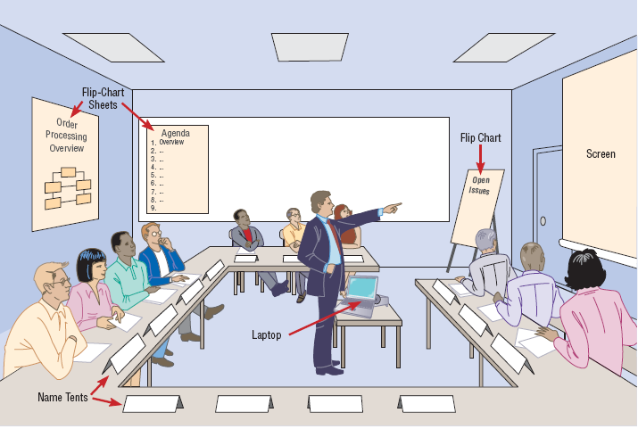

Slide 30
Using Prototyping during Requirements Determination
Prototyping is basically a repetitive process in which analysts and users build a rudimentary version of an information system based on user feedback
It can replace the systems development life cycle or augment it
Prototyping allows you to quickly convert basic requirements into a working, though limited, version of the desired information system
The goal with using prototyping to support requirements determination is to develop concrete specifications for the ultimate system, not to build the ultimate system

Slide 31
Prototyping
Prototyping is most useful for requirements determination when:
User requirements are not clear or well understood, which is often the case for totally new systems.
One or a few users and other stakeholders are involved with the system.
Possible designs are complex and require concrete form to evaluate fully.
Communication problems have existed in the past between users and analysts, and both parties want to be sure that system requirements are as specific as possible.

Slide 32
Prototyping Drawbacks
Prototyping also has some drawbacks as a tool for requirements determination. They include:
A tendency to avoid creating formal documentation of system requirements, which can then make the system more difficult to develop into a fully working system.
Prototypes can become idiosyncratic to the initial user and difficult to diffuse or adapt to other potential users.
Prototypes are often built as stand-alone systems, thus ignoring issues of sharing data and interactions with other existing systems.

Slide 33
System requirement specification
Systems requirement specification (SRS) is a document that contains such things as functional and non-functional requirement
SRS is the most referenced document through out the system development process.
Functional requirements: refer to major business functionalities of the system that it should possess (Business Support needs aspects - the “what” )
Non-Functional requirements : refer to additional features of the system (Quality aspects-the “how good”)

Slide 34
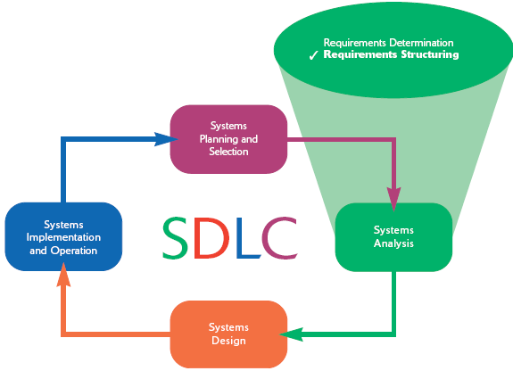

Slide 35
Process Modeling
Process modeling involves graphically representing the processes, or actions, that capture, manipulate, store, and distribute data between a system and its environment and among components within a system.
A common form of a process model is a data-flow diagram (DFD)

Slide 36
Data-Flow Diagramming Mechanics
Data-flow diagrams are versatile diagramming tools.
With only four symbols, data-flow diagrams can represent both physical and logical information systems.
The four symbols used in DFDs represent data flows, data stores, processes, and sources/sinks (or external entities)

Slide 37
DFD Elements..
A data flow:
is data that is in motion and moving as a unit from one place in a system to another
A data flow could represent:
data on a customer order form or a payroll check
a query to a database
the contents of a printed report
data on a data-entry computer display form
A data flow can be composed of many individual pieces of data that are generated at the same time and that flow together to common destinations

Slide 38
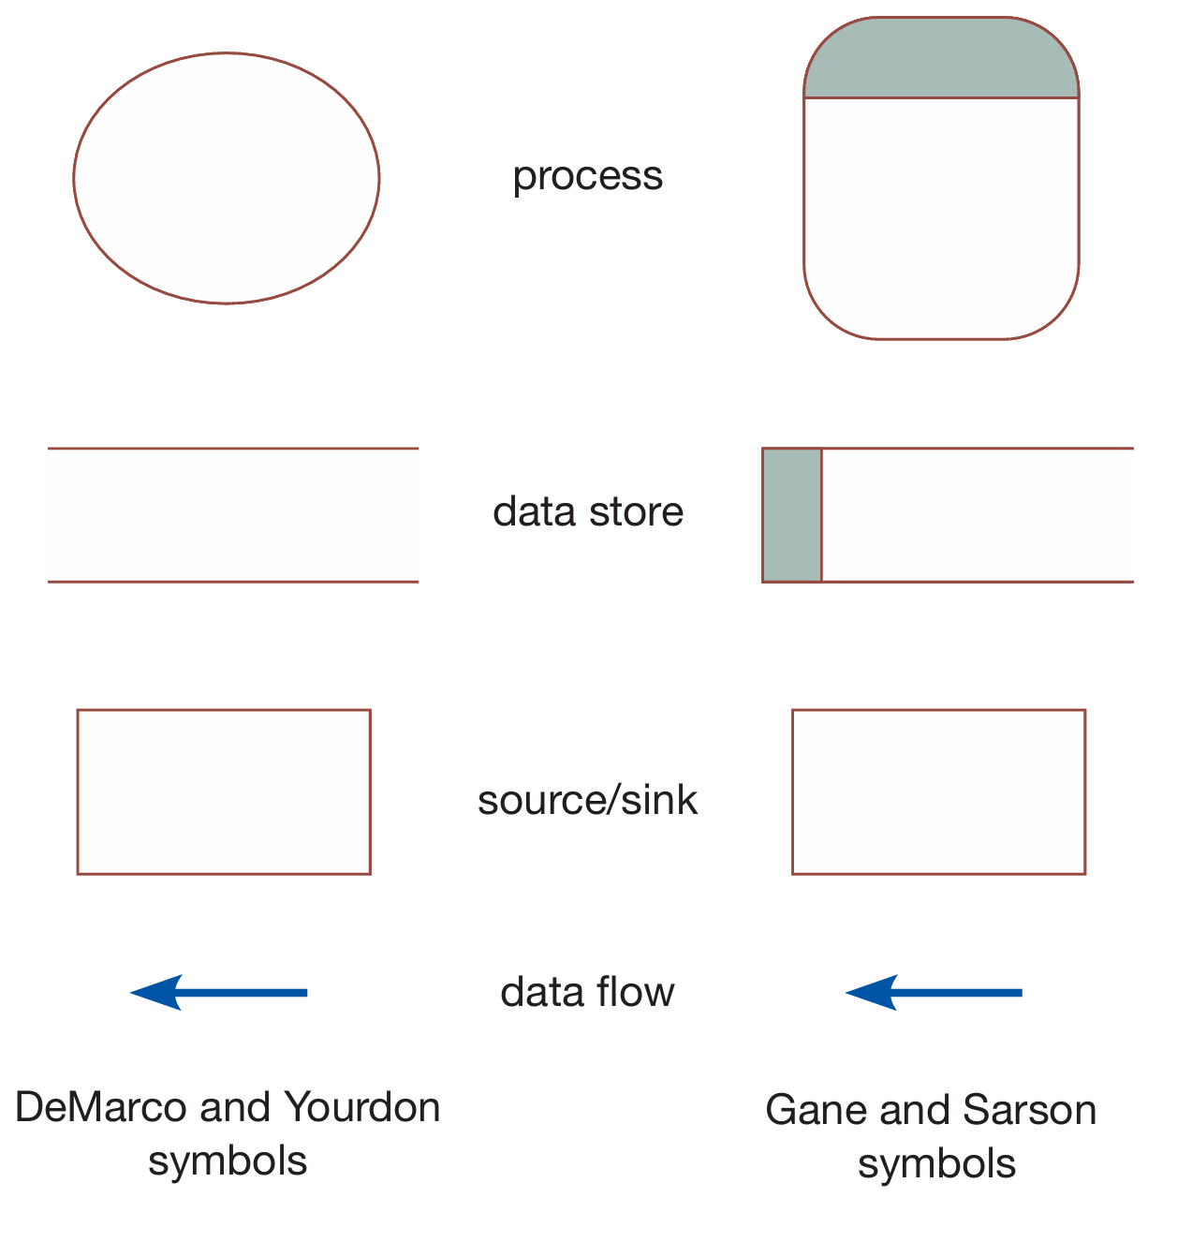
DFD Elements…
A data store:
is data at rest
may represent one of many different physical locations for data, including a file folder, one or more computer-based file(s), tables, or a notebook
might contain data about customers, students, customer orders, or supplier invoices
A process:
is the work or actions performed on data so that they are transformed, stored, or distributed

Slide 39
DFD Elements….
A source/sink:
is the origin and/or destination of the data
are sometimes referred to as external entities because they are outside the system
Because sources and sinks are outside the system, many of their characteristics are of no interest to the analyst
A source/sink might consist of the following:
Another organization or organizational unit that sends data to or receives information from the system you are analyzing
A person inside or outside the business unit supported by the system you are analyzing and who interacts with the system
Another information system with which the system you are analyzing exchanges information

Slide 40
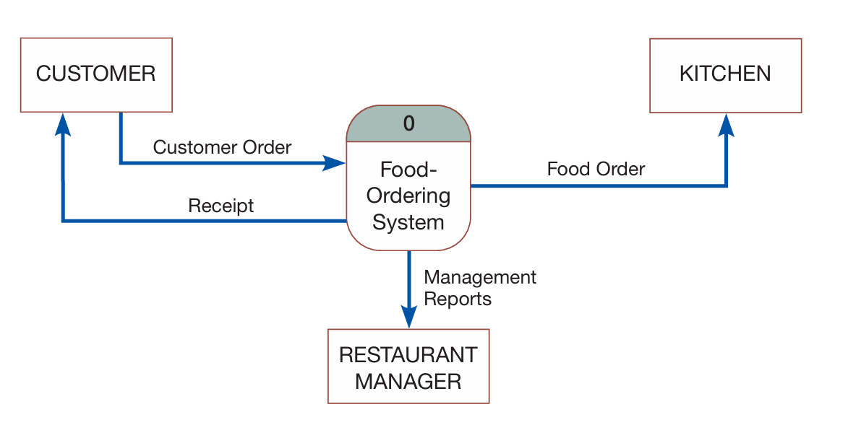
Developing DFDs: An Example
Context diagram: is a data-flow diagram of the scope of an organizational system that shows
the system as a single process model along with boundaries,
external entities that interact with the system, and
the major information flows between the entities and the system.

Slide 41
Developing DFDs cont’d
Note that data stores do not appear on a context diagram as the data stores of the system are conceptually inside the one process, the entire system
The analyst must determine which processes are represented by the single process in the context diagram.
we have identified four processes (1.0, 2.0, 3.0, and 4.0) while decomposing context DFD into Level 0 DFD (next slide)

Slide 42
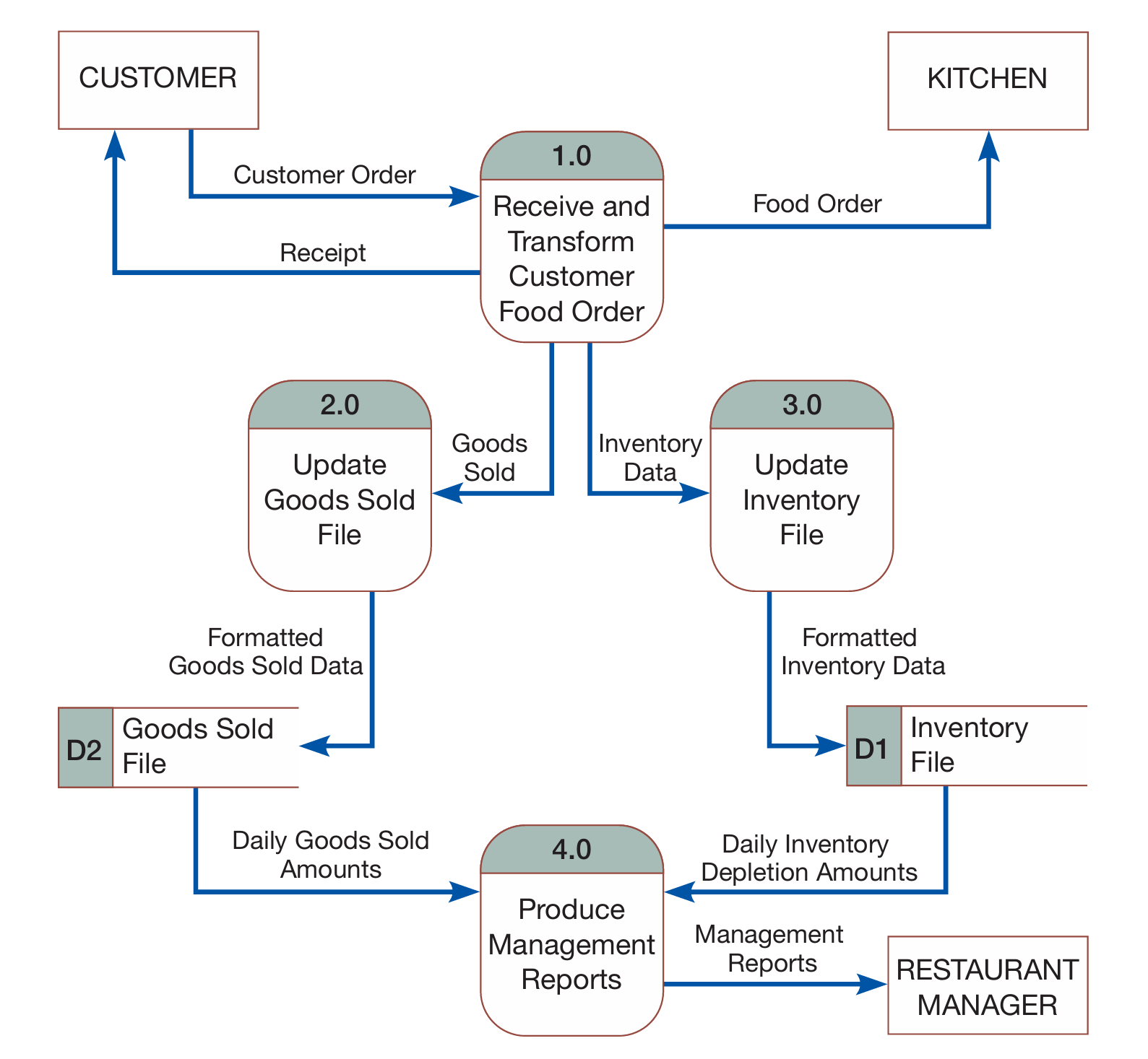
Level 0 DFD Diagram
Level-0 diagram is a data-flow diagram that represents
a system’s major processes,
data flows, and
data stores at a high level of detail.

Slide 43
Logical Vs Physical DFDs
A logical DFD focuses on the business and business activities, while a physical DFD looks at how a system is implemented.
So while any data flow diagram maps out the flow of information for a process or system, the logical diagram provides the what and how of the business and the physical provides how the business logic is implemented

Slide 44
Logical Vs Physical DFDs
Design Feature | Logical | Physical
What the model depicts | How the business operates. | How the system will be implemented (or how the current system operates).
What the processes represent | Business activities. | Programs, program modules, and manual procedures.

Slide 45
Logical Vs Physical DFDs
Design Feature | Logical | Physical
What the data stores represent | Collections of data regardless of how the data are stored. | Physical files and databases, manual files.
Type of data stores | Show data stores representing permanent data collections. | Master files, transition files. Any processes that operate at two different times must be connected by a data store.
System controls | Show business controls. | Show controls for validating input data, for obtaining a record (record found status), for ensuring successful completion of a process, and for system security (example: journal records).

Slide 46
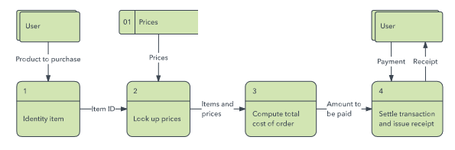
Logical DFD - Example

Slide 47
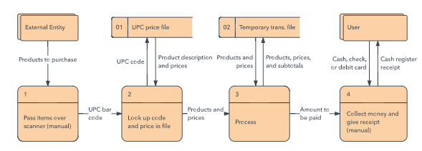
Physical DFD – An Example

Slide 48
Data-Flow Diagramming Rules
Process
No process can have only outputs. It is making data from nothing (a miracle). If an object has only outputs, then it must be a source
No process can have only inputs (a black hole). If an object has only inputs, then it must be a sink.
A process has a verb-phrase label.

Slide 49
DFD Rules
Data Store
Data cannot move directly from one data store to another data store. Data must be moved by a process.
Data cannot move directly from an outside source to a data store. Data must be moved by a process that receives data from the source and places the data into the data store
Data cannot move directly to an outside sink from a data store. Data must be moved by a process.
A data store has a noun-phrase label.

Slide 50
DFD Rules
Source/Sink
Data cannot move directly from a source to a sink. They must be moved by a process if the data are of any concern to our system. Otherwise, the data flow is not shown on the DFD.
A source/sink has a noun-phrase label.

Slide 51
Data Flow Diagram rules
A data flow has only one direction of flow between symbols. It may flow in both directions between a process and a data store to show a read before an update. The latter is usually indicated, however, by two separate arrows because the read and update usually happen at different times.
A fork in a data flow means that exactly the same data goes from a common location to two or more different processes, data stores, or sources/sinks (it usually indicates different copies of the same data going to different locations).
A join in a data flow means that exactly the same data come from any of two or more different processes, data stores, or sources/sinks to a common location.

Slide 52
Data Flow Diagram rules (cont’d)
A data flow cannot go directly back to the same process it leaves. At least one other process must handle the data flow, produce some other data flow, and return the original data flow to the beginning process.
A data flow to a data store means update (delete or change).
A data flow from a data store means retrieve or use.
A data flow has a noun-phrase label. More than one dataflow noun phrase can appear on a single arrow as long as all of the flows on the same arrow move together as one package.

Slide 53
Decomposition of DFDs
The act of dividing a single system to its component processes is called (functional) decomposition
Functional decomposition is a repetitive process of breaking the description or perspective of a system down into finer and finer details
Decomposition continues until no sub-process can logically be broken down any further
The lowest level of DFDs is called a primitive DFD

Slide 54
Example 1: Decomposing a level-0 DFD
This example shows us decomposing the process called “Receive and Transform Customer Food Order” into:
Receive a customer order
transform the entered order into a printed receipt for the customer
transform the order into a form meaningful for the kitchen’s system
transform the order into goods sold data, and
transform the order into inventory data

Slide 55

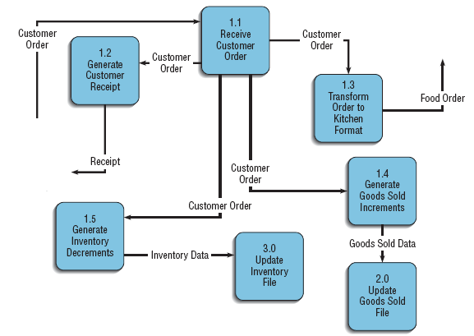

Slide 56
DFD Decomposition
Note in the previous slide that:
each of the five processes are labeled as sub-processes of Process 1.0: Process 1.1, Process 1.2, and so on
each of the processes and data flows are named
No sources or sinks are represented
This type of data-flow diagram is called a level-1 diagram
In general, a level-n diagram is a DFD that is generated from n nested decompositions from a level-0 diagram.

Slide 57
Example 2: Decomposing a level-0 DFD
This example shows us decomposing the process called “Produce Management Reports” into:
Access Goods Sold and Inventory Data
Aggregate Goods Sold and Inventory Data
Prepare Management Reports

Slide 58

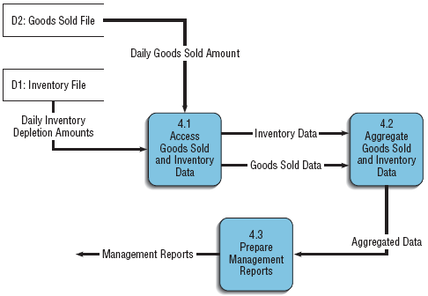

Slide 59

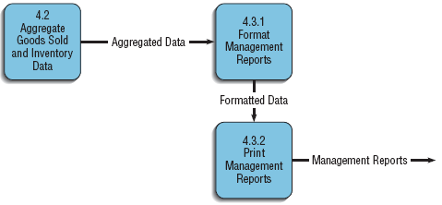
Creating a level-2 diagram

Slide 60
Balancing DFDs
Balancing refers to the conservation of inputs and outputs to a data-flow diagram process when that process is decomposed to a lower level.
For example, Process 1.0, which appears in a level-0 diagram, must have the same inputs and outputs when decomposed into a level-1 diagram

Slide 61
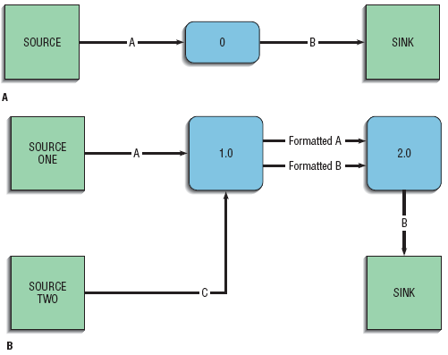
Example: An unbalanced set of data flow diagrams

Slide 62
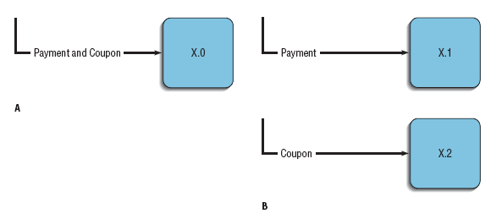
DFD Balancing
A data flow consisting of several sub-flows on a level-n diagram can be split apart on a level-n+1 diagram for a process that accepts this composite data flow as input

Slide 63
Guidelines for Drawing DFDs
An understanding of how to correctly use a DFD is important because data-flow diagrams are essential tools for the structured analysis process.
The guidelines for effective structuring of the analysis process include:
Completeness
Consistency
Timing considerations
The iterative nature of drawing DFD
Drawing primitive DFD

Slide 64
DFD Drawing Guidelines
DFD completeness: refers to the extent to which all necessary components of a data-flow diagram have been included and fully described.
DFD consistency: refers to the extent to which information contained on one level of a set of nested data-flow diagrams is also included on other levels.

Slide 65
DFD Drawing Guidelines
DFD Timing: refers to drawing the DFD as if the system you are modeling has never started and will never stop ( no timing considerations)
DFD Iterative Development: refers to counting on drawing the same diagram over and over again, in an iterative fashion. Iterative DFD development recognizes that requirements determination and requirements structuring are interacting, not sequential, sub-phases of the analysis phase of the SDLC.

Slide 66
DFD Drawing Guidelines
Primitive DFDs: One of the most difficult decisions you need to make when drawing DFDs is when to stop decomposing processes.
One rule is to stop drawing when you have reached the lowest logical level; however, it is not always easy to know what the lowest logical level is

Slide 67
Logic Modeling
Although data-flow diagrams are good for identifying processes, they do not show the logic inside the processes
Because data-flow diagrams are not really designed to show the detailed logic of processes, you must model process logic using other techniques
Logic modeling involves representing the internal structure and functionality of the processes represented on data-flow diagrams

Slide 68
Modeling Logic with Decision Tables
Decision table is a matrix representation of the logic of a decision, which specifies the possible conditions for the decision and the resulting actions.
A decision table has three parts:
Condition stubs is part of a decision table that lists the conditions relevant to the decision.
Action stubs is part of a decision table that lists the actions that result for a given set of conditions.
Rules is part of a decision table that specifies which actions are to be followed for a given set of conditions.

Slide 69
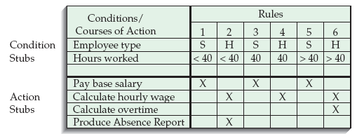
Logic Modelling -Example

Slide 70
Logic Modelling .. Conditions
Indifferent condition: is a condition whose value does not affect which actions are taken for two or more rules.
The number of hours worked does not affect the outcome for rules 1, 3, or 5 in the example of the previous slide. For these rules, hours worked is an indifferent condition, in that its value does not affect the action taken
Such conditions can be used to reduce the number of rules and thereby simplifying the table as shown in the next slide

Slide 71
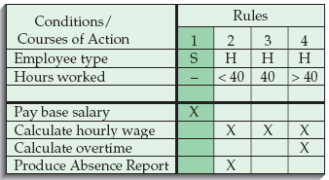
Decision Table - Example

Slide 72
Decision Table Basic Procedures
In constructing decision tables, the general set of basic procedures to be followed are:
Name the conditions and the values each condition can assume.
Name all possible actions that can occur.
List all possible rules.
Define the actions for each rule.
Simplify the decision table.

Slide 73
Modeling Logic with Decision Trees
A graphical representation of a decision situation
Decision situation points are connected together by arcs and terminate in ovals
Two main components
Decision points represented by nodes
Actions represented by ovals

Slide 74
Decision Trees – procedure
Read from left to right
Each node corresponds to a numbered choice on a legend
All possible actions are listed on the far right(Ovals)

Slide 75
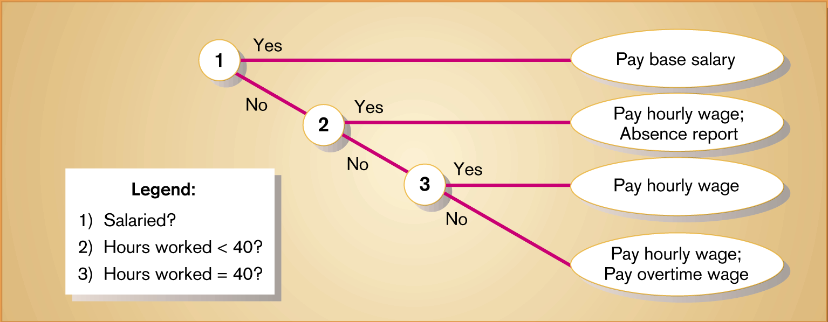
Decision Tree - Example

Slide 76
Modeling Logic with Structured English
Structured English is a modified form of the English language used to specify the logic of information system processes.
Although there is no single standard, structured English typically relies on action verbs and noun phrases and contains no adjectives or adverbs.
It is possible to use Structured English to represent all three processes typical of structured programming: sequence, conditional statements, and repetition.

Slide 77
Logic with Structured English
Conditional statement
BEGIN IF
IF Quantity-in-stock is less than Minimum-order-quantity
THEN GENERATE new order
ELSE DO nothing
END IF
Repetition
DO
BEGIN IF
IF Quantity-in-stock is less than Minimum-order-quantity
THEN GENERATE new order
ELSE DO nothing
END IF
UNTIL End-of-file

Slide 78
Conceptual Data Modeling
A conceptual data model is a representation of organizational data.
The purpose of a conceptual data model is to show as many rules about the meaning and interrelationships among data as possible, independent of any database management system or other implementation considerations.
Entity-relationship (E-R) data model is a commonly used diagram that shows how data are organized in an information system.

Slide 79
Conceptual Data Modelling
The main goal of conceptual data modeling is to create accurate E-R diagrams
Methods such as interviewing, questionnaires, and JAD sessions can be used to collect information for conceptual data modeling
On larger systems development teams, a subset of the project team concentrates on data modeling while other team members focus attention on process or logic modeling

Slide 80
Conceptual Modelling…
Since the process flow, decision logic, and data-model descriptions of a system describe different but complementary views of the same information system, they must be consistent and complete.
For example, the names of data stores on primitive-level DFDs often correspond to the names of data entities in entity-relationship diagrams, and the data elements in data flows on DFDs must be attributes of entities and relationships in entity-relationship diagrams

Slide 81
Introduction to Entity-Relationship Modeling
The basic entity-relationship modeling notation uses three main constructs:
data entities
relationships, and
Attributes
An entity-relationship diagram (or E-R diagram ) is a detailed, logical, and graphical representation of the data for an organization or business area

Slide 82
E-R Modelling…
The E-R diagram is a model of entities in the business environment, the relationships or associations among those entities, and the attributes or properties of both the entities and their relationships
A rectangle is used to represent an entity, and lines are used to represent the relationship between two or more entities

Slide 83
Entities
An entity is a person, place, object, event, or concept in the user environment about which the organization wishes to maintain data
An entity has its own identity, which distinguishes it from every other entity
Some examples of entities are:
Person: EMPLOYEE, STUDENT, PATIENT
Place: CITY, REGION, COUNTRY, BRANCH
Object: MACHINE, BUILDING, AUTOMOBILE, PRODUCT
Event: SALE, REGISTRATION, RENEWAL
Concept: ACCOUNT, COURSE

Slide 84
Entity type
Entity type is a collection of entities that share common properties or characteristics.
Each entity type in an E-R model is given a name
The name is written in singular form
A simple noun is used to name an entity type
Capital letters are used in naming an entity type, and in an E-R diagram, the name is placed inside a rectangle representing the entity

Slide 85
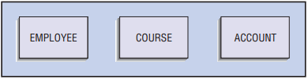
Entity Types -Examples
Example of Entity type:

Slide 86
Entity instance
An entity instance (or instance) is a single occurrence of an entity type
An entity type is described just once in a data model, whereas many instances of that entity type may be represented by data stored in the database
For example, most organizations have one EMPLOYEE entity type, but hundreds of instances of this entity type may be stored in the database

Slide 87
Attributes
Each entity type has a set of attributes associated with it
An attribute is a property or characteristic of an entity that is of interest to the organization
Following are some typical entity types and associated attributes:
STUDENT: Student_ID, Student_Name, Address, Phone_Number, Major
AUTOMOBILE: Vehicle_ID, Color, Weight, Horsepower
EMPLOYEE: Employee_ID, Employee_Name, Address, Skill

Slide 88
Attributes ….
We use nouns with an initial capital letter followed by lowercase letters in naming an attribute
In E-R diagrams, we represent an attribute by placing its name inside the rectangle that represents the associated entity

Slide 89
Candidate Keys and Identifiers
Every entity type must have an attribute or set of attributes that distinguishes one instance from other instances of the same type
A candidate key is an attribute (or combination of attributes) that uniquely identifies each instance of an entity type
A candidate key for a STUDENT entity type might be Student_ID

Slide 90
Entity Identifiers
Some entities may have more than one candidate key
One candidate key for EMPLOYEE is Employee_ID; a second is the combination of Employee_Name and Address (assuming that no two employees with the same name live at the same address)
An identifier is a candidate key that has been selected to be used as the unique characteristic for an entity type

Slide 91
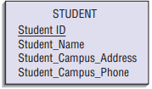
Entity identifier in E-R
For each entity, the name of the identifier is underlined on an E-R diagram.

Slide 92
Multi-valued Attributes
A multi-valued attribute may take on more than one value for each entity instance
Suppose that, Skill is one of the attributes of EMPLOYEE. If each employee can have more than one Skill, then it is a multi-valued attribute
During conceptual design, two common special symbols or notations are used to high-light multi-valued attributes

Slide 93
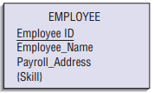
Multi-valued Attributes in E-R
First approach is the use of curly brackets which are one type of notations used around the name of the multivalued attribute

Slide 94
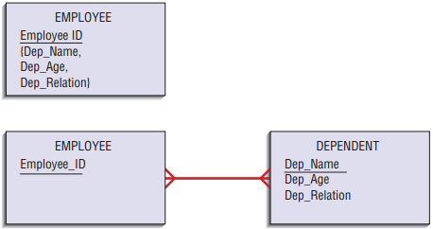
a second approach is to represent the multivalued attribute as another entity, called a weak (or attributive) entity, and then using a relationship link of the weak entity to its associated regular entity
The approach also easily handles several attributes that repeat together, called a repeating group as shown in the above example.

Slide 95
Relationships
Relationships are the glue that hold the various entities together in an E-R model
A relationship is an association between the instances of one or more entity types that are of interest to the organization
An association usually means that there is an event or that some natural linkage exists between entity instances
For this reason, relationships are labeled with verb phrases

Slide 96
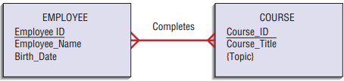
Relationships ….
For example, a training department in a company is interested in tracking which training courses each of its employees has completed

Slide 97
Degree of a Relationship
The degree of a relationship is the number of entity types that participate in that relationship
The three most common relationships in E-R diagrams are:
unary (degree one)
binary (degree two), and
ternary (degree three)

Slide 98


Unary Relationship
Unary relationship (recursive relationship) is a relationship between the instances of one entity type.

Slide 99

Binary Relationship
A binary relationship is a relationship between instances of two entity types and is the most common type of relationship encountered in data modeling

Slide 100
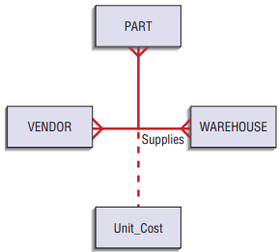
Ternary Relationship
A ternary relationship is a simultaneous relationship among instances of three entity types

Slide 101
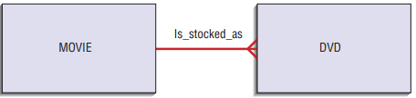
Cardinalities in Relationships
Cardinality is the number of instances of entity B that can (or must) be associated with each instance of entity A

Slide 102
Minimum and Maximum Cardinalities (Multiplicity)
The minimum cardinality of a relationship is the minimum number of instances of entity B that may be associated with each instance of entity A
When the minimum cardinality of a relationship is zero, then we say entity B is an optional participant in the relationship
When the minimum cardinality of a relationship is one or more, then we say entity B is a mandatory participant in the relationship

Slide 103
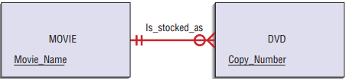
The maximum cardinality is the maximum number of instances
The zero through the line near the DVD entity means a minimum cardinality of zero, whereas the crow’s-foot notation means a “many” maximum cardinality.
It is possible for the maximum cardinality to be a fixed number, not an arbitrary “many” value

Slide 104

Associative Entities
Attributes sometimes may be associated with a many-to-many relationship
For example, suppose that an organization wishes to record the date (month and year) when an employee completes each course

Slide 105
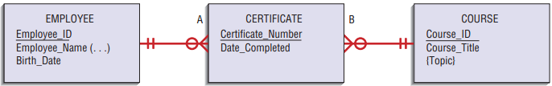
From the data of the previous slide you can conclude that the attribute Date-Completed is not a property of the entity EMPLOYEE. Nor is Date-Completed a property of COURSE, because a particular course may be completed on different dates
Instead, Date-Completed is a property of the relationship between EMPLOYEE and COURSE as depicted below

Slide 106
Selecting the Best Alternative Design Strategy
Selecting the best alternative system involves at least two basic steps:
generating a comprehensive set of alternative design strategies, and
(2) selecting the one that is most likely to result in the desired information system, given all of the organizational, economic, and technical constraints that limit what can be done

Slide 107
Alternative Selection…
A system design strategy represents a particular approach to developing the system
Selecting a strategy requires you to answer questions about the system’s functionality, hardware and system software platform, and method for acquisition
After the system requirements have been structured in terms of process flow and data, analysts again work with users to package the requirements into different system configurations

Slide 108
Shaping alternative system design strategies involves the following processes:
Dividing requirements into different sets of capabilities, ranging from the bare minimum that users would accept to the most elaborated and advanced system the company could afford to develop
Enumerating different potential implementation environments that could be used to deliver the different sets of capabilities
Proposing different ways to acquire the various sets of capabilities for the different implementation environments.

Slide 109
A good number of alternatives for analysts to generate is three because three alternatives can neatly represent low, middle, and high ranges of potential solutions
Low-end alternatives are the most conservative in terms of the effort, cost, and technology involved in developing a new system
High-end alternatives go beyond simply solving the problem in question and focus instead on systems that contain many extra features users may desire
Mid-range alternatives repesent compromise in solutions to be developed

Slide 110
Alternative Solutions..
How do you know where to draw bounds around the potential solution space?
At the end of analysis, a survey can be conducted to rate different features of the system as mandatory and desired features.
Mandatory features are the ones that everyone agrees are necessary to solve the problem or meet the opportunity
Desired features are those that users could live without

Slide 111
Features can take many different forms as:
Data kept in system files: For example, multiple customer addresses so that bills can be sent to addresses different from where we ship goods.
System outputs: Printed reports, online displays, transaction documents (for example, a paycheck or sales summary graph).
Analyses to generate the information in system outputs: For example, a sales forecasting module or an installment billing routine.
Expectations on accessibility, response time, or turnaround time for system functions: For example, online, real-time updating of inventory files

Slide 112
Constraints that are used in drawing bounds around alternative strategies include:
A date when the replacement system is needed.
Available financial and human resources.
Elements of the current system that cannot change.
Legal and contractual restrictions
The importance or dynamics of the problem that may limit how the system can be acquired

Slide 113
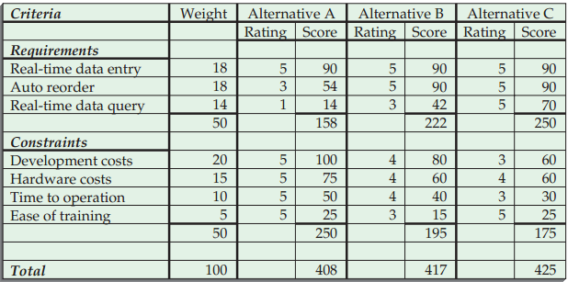
Selection of Alternatives- Example

Slide 114
Issues to Consider in Generating Alternatives
Outsourcing
The practice of turning over responsibility of some to all of an organization’s information systems applications and operations to an outside firm
Can provide a cost effective solution
Sources of Software
Hardware manufacturers
Packaged software producers
Custom software producers
Enterprise solution software
Application Service Providers
In-house development

Slide 115
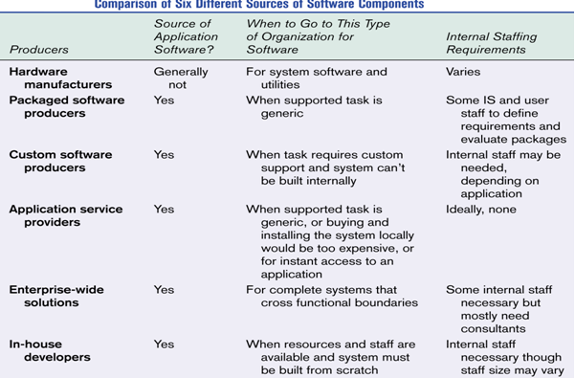

Slide 116
Criteria for Choosing Off-the-Shelf Software
Cost
In-House versus purchased
Functionality
Mandatory, essential and desired features
Vendor Support
Installation
Training
Technical Support
Viability of Vendor

Slide 117
Criteria for Choosing Off-the-Shelf Software
Flexibility
Ease of customization
Documentation
User documentation
Technical documentation
Response Time
Ease of Installation

Slide 118
Validating Purchased Software Information
Information from vendor
Request for proposal
A document provided to vendors to ask them to propose hardware and system software that will meet the requirements of your new system
Software evaluation period
Customer references from vendor
Independent software testing service
Trade publications

Slide 119
Implementation and Organizational Issues
Implementation Issues
Technical and social aspects of implementation need to be addressed
Training
Disruption of work
Organizational Issues
Overall cost and availability of funding
Management support
User acceptance

Slide 120
End of chapter questions
Associate the following terms with their corresponding definitions (next slide)
Business process reengineering (BPR)
Closed-ended questions
Disruptive technologies
Formal system
Informal system
JAD session leader
Joint Application Design (JAD)
Key business processes
Nominal Group Technique (NGT)
Open-ended questions
Prototyping
Scribe

Slide 121
End of chapter questions cont’d
Associate the following definitions with their corresponding terms (previous slide)
____Questions in interviews that ask those responding to choose from among a set of specified responses.
____ Technologies that enable breaking long-held business rules that inhibit organizations from making radical business changes.
____ A facilitated process that supports idea generation by groups. At the beginning of the process, group members work alone to generate ideas. The ideas are then pooled under the guidance of a trained facilitator.
____ The structured, measured set of activities designed to produce a specific output for a particular customer or market.
____ An iterative process in which requirements are converted to a working system that is continually revised through organized user collaboration.
____The official way a system works as described in organizational documentation.

Slide 122
End of chapter questions cont’d
Associate the following definitions with their corresponding terms (previous slide) cont’d
____The search for, and implementation of, radical change in business processes to achieve breakthrough improvements in products and services.
____ The way a system actually works.
____ The person who makes detailed notes of the happenings at a JAD session.
____ Questions in interviews that have no pre-specified answers.
____ The trained individual who plans and leads JAD sessions.
____ A structured process in which users, managers, and analysts work together for several days in a series of meetings to clarify or review requirements.

Slide 123
End of chapter questions cont’d
Describe the following terms
DFD diagramming rules
Balanced DFD
Challenges of functional decomposition
Business rules
Candidate key vs primary key
Cardinality vs degree of relationship
Entity instance vs entity type
Multivalued attribute vs composite attribute

Slide 124
End of chapter questions cont’d
Discuss the following
How is a data model employed when structuring system data requirements?
Discuss the relationship between business rules and data models.
Why do systems analysts need to collect system data for conceptual data modeling?
What are the linkages among DFDs, decision tables, and E-R diagrams?
What is the role of an entity-relationship diagram in data modeling?
How are relationships classified? Give an example of each

Slide 125
End of chapter three

